Slide 1
LINQ for XML and Objects , LINQ to XML , LINQ to Object
Presented by :
M.Awais
Umar Bilal
M.Ahsan

Slide 2

LINQ for XML and Objects: Harnessing the Power of Data
LINQ, or Language Integrated Query, is a powerful feature in .NET that revolutionizes data manipulation. It provides a unified way to query and transform data from various sources, including XML documents and collections of objects.

Slide 3
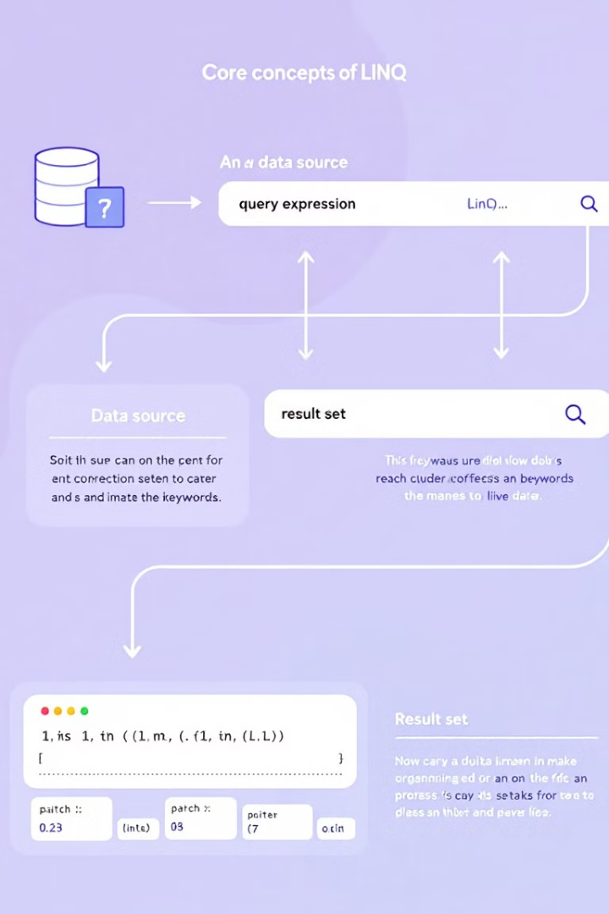
Understanding LINQ: A Brief Overview
1
Unified Syntax
2
Query Expressions
LINQ introduces a consistent syntax for querying and manipulating data across different data sources.
LINQ queries are expressed in a declarative style, focusing on what to retrieve rather than how to retrieve it.
3
Extensible Framework
LINQ's extensibility allows developers to create custom LINQ providers for new data sources.

Slide 4
LINQ to XML: Seamless XML Data Manipulation
XML Data Access
Query Capabilities
Object Model
LINQ to XML provides a streamlined approach to accessing and working with XML data.
LINQ queries allow for easy filtering, sorting, and projection of XML data.
LINQ to XML treats XML documents as object models, enabling intuitive data manipulation.

Slide 5





Querying XML Documents with LINQ
Querying XML
LINQ provides a concise and expressive way to query XML data.
Filtering Elements
Use LINQ methods like Where to filter elements based on specific criteria.
Selecting Data
Select specific elements, attributes, or values using LINQ's Select methods.
Ordering Results
Apply the OrderBy or OrderByDescending methods to sort the retrieved data.

Slide 6

Transforming XML Data Using LINQ
LINQ Method
Description
Select
Transforms data into a new format.
Where
Filters data based on specific criteria.
OrderBy
Sorts data in ascending or descending order.
GroupBy
Groups data based on a shared attribute.

Slide 7
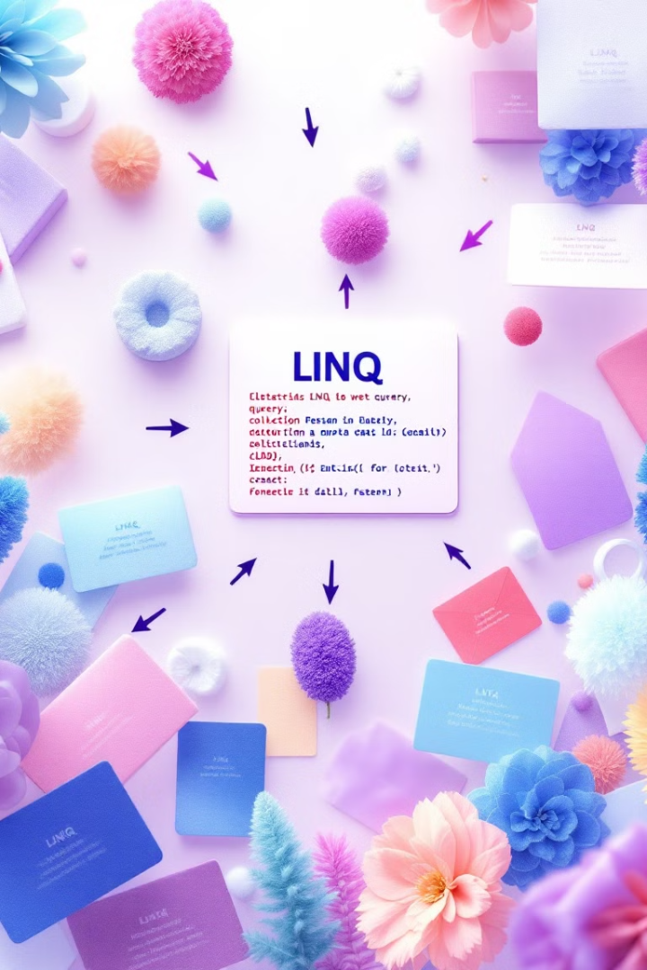
LINQ to Objects: Unlocking the Potential of Collections
Querying Collections
Data Access
LINQ to Objects enables powerful querying and manipulation of collections of objects.
LINQ provides a consistent approach to access and work with data in collections.
Object-Oriented Paradigm
LINQ to Objects seamlessly integrates with the object-oriented paradigm.

Slide 8




Querying and Filtering Objects with LINQ
Filtering
Searching
Sorting
Filter collections based on specific property values.
Find objects that match particular criteria.
Arrange objects in ascending or descending order.

Slide 9
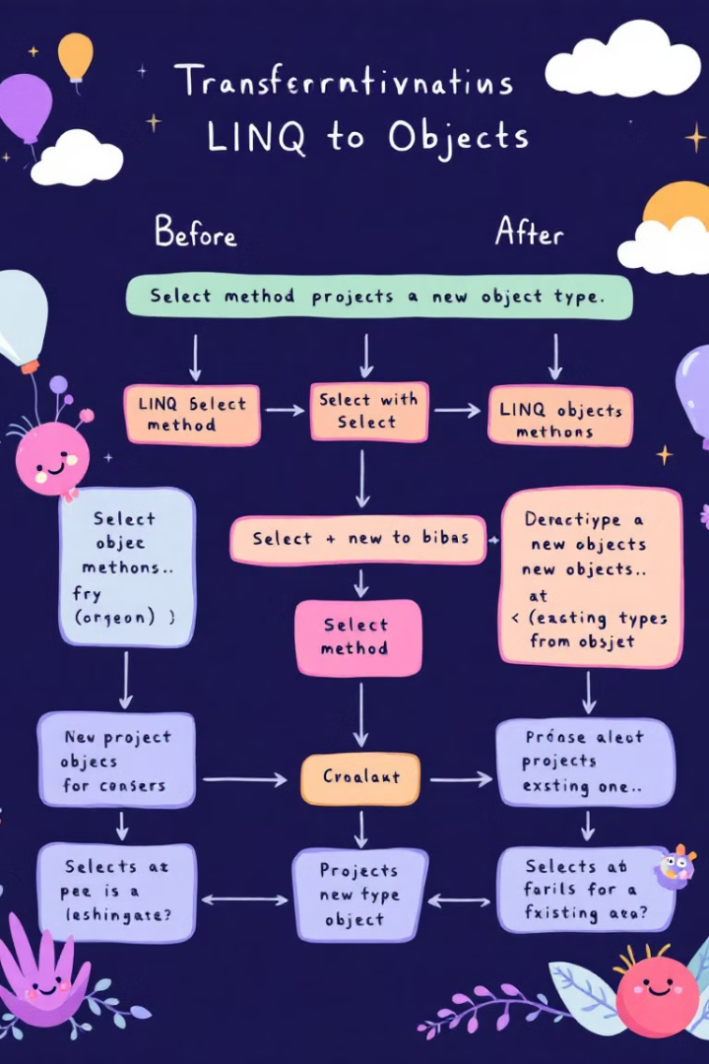
Projecting and Transforming Objects
1
Projecting
Transform objects into different data structures or representations.
2
Selecting Properties
Select specific properties from objects based on criteria.
3
Creating New Objects
Create new objects from existing objects using LINQ's projection capabilities.

Slide 10

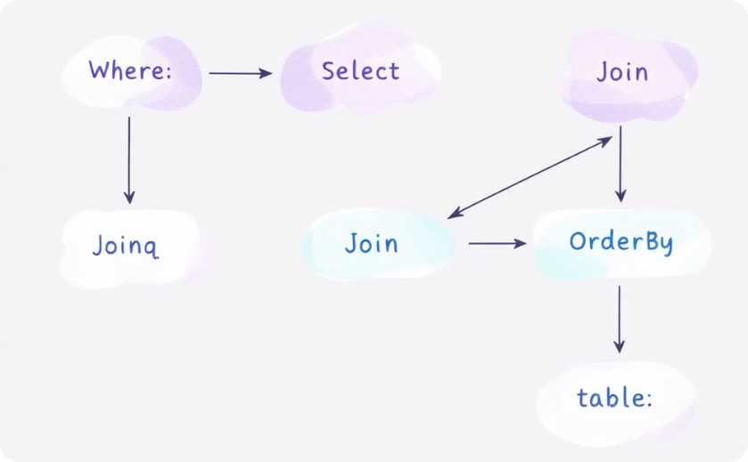
Combining LINQ with Visual Programming
Visual Query Builders
Workflow Diagrams
Visual programming tools simplify LINQ query creation.
Visualize LINQ query logic using workflow diagrams.

Slide 11

Conclusion and Key Takeaways
LINQ empowers developers with a unified and expressive way to work with data, fostering code reusability and simplifying complex data manipulation tasks. Whether querying XML documents or manipulating collections of objects, LINQ provides a flexible and powerful framework for data-driven applications.

Slide 12
Thanks

